Slide 1
.NET 6
Long Term Evolution ?
Leszek Kowalski Michał Bryłka Capgemini

Slide 2


Who are we ?
Leszek
Team lead / soft dev
Michał
Tech lead / soft dev

Slide 3
Agenda
NET 6
New Features
API improvements
Performance improvements
C# 10.0
New features
Demo
Discussion Panel

Slide 4
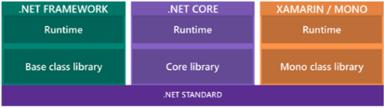
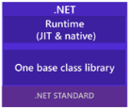
.NET 6.0
LTS successor of both .NET 5 and .NET Framework 4.x
Cross-platform
Open-source
Side-by-side installation
Not a superset of .NET Framework
Web Forms, WCF, WF not included

Slide 5
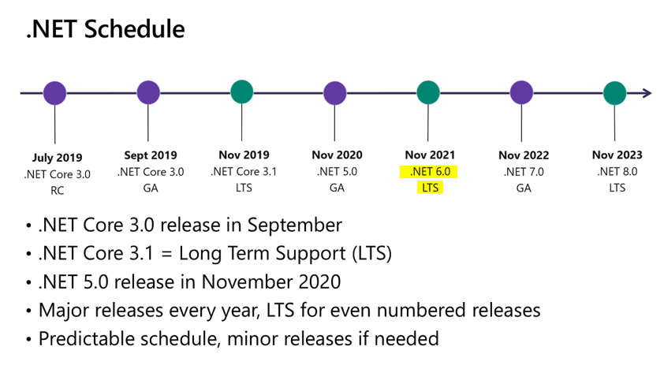
Release Schedule

Slide 6
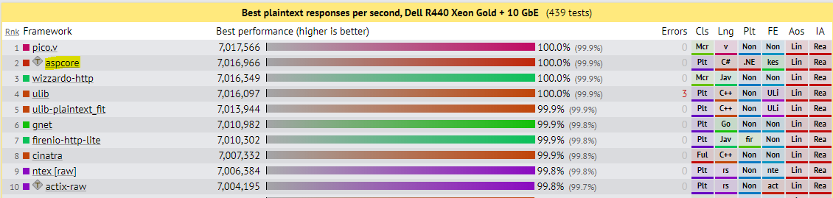
Optimizations
TechEmpower Benchmarks – Plaintext:
https://www.techempower.com/benchmarks/#section=data-r20&hw=ph&test=plaintext

Slide 7
Inner-Loop Performance
Operations devs do mutiple times a day
Hot reload
MSBuild Speedup

Slide 8


Inner-Loop Performance
Hot Reload
Types
Iterators
Async/await expressions
LINQ expressions
Lambdas
Dynamic objects
Renaming elements
Deleting namespaces, types and members
Adding or modifying generics
Modifying interfaces
Modifying method signatures

Slide 9
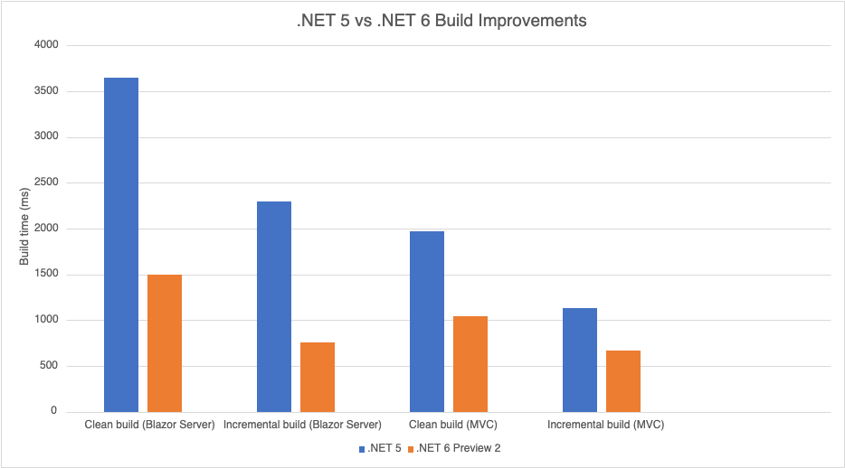
Inner-Loop Performance
MSBuild Speedup

Slide 10
SDK Workloads
Download only workloads in use
Minimal set for CI/CD
Workloads versioned separately from SDK
Many implicit deps versions hardcoded in MSBuilds Targets

Slide 11
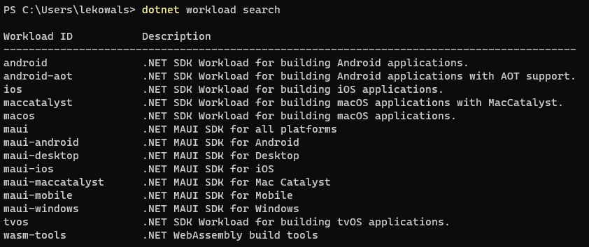
SDK Workloads
dotnet workload list will tell you which workloads you have installed.
dotnet workload update will update all installed workloads to the newest available version

Slide 12
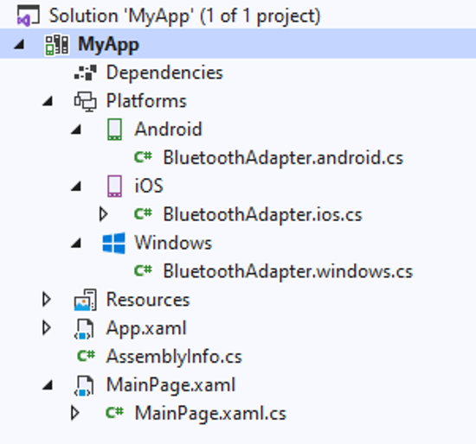
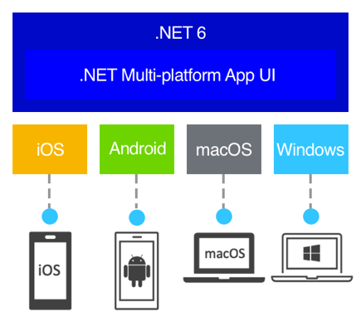
MAUI – Multi-platform App UI

Slide 13
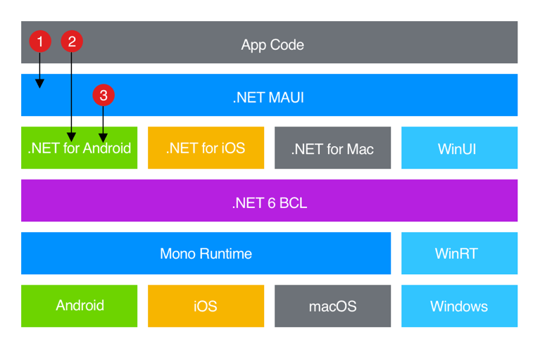
MAUI – Multi-platform App UI

Slide 14


Package Validation Tooling
dotnet add package Microsoft.DotNet.PackageValidation
<Sdk Name="Microsoft.DotNet.PackageValidation" Version="1.0.0-preview.5.21302.8" />
<PackageValidationBaselineVersion>1.0.0</PackageValidationBaselineVersion>
breaking changes across package versions.

Slide 15
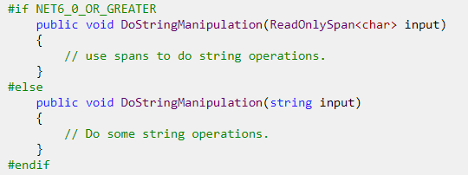
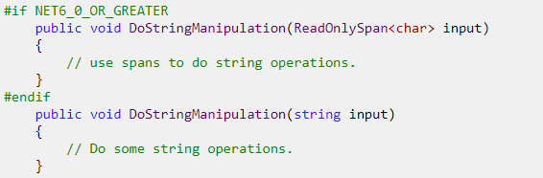
Package Validation Tooling
Inconsistent API between target frameworks

Slide 16
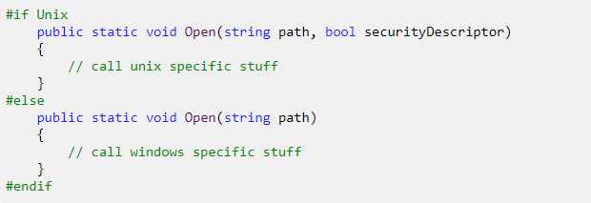
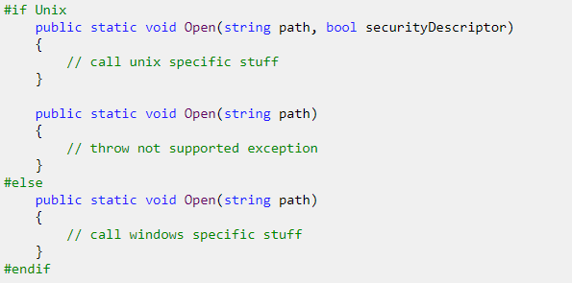
Package Validation Tooling
Inconsistent API on different runtimes
https://devblogs.microsoft.com/dotnet/package-validation/

Slide 17

Quiz – let’s play
Kahoot.it

Slide 18
API Improvements
Date/Time
DateOnly var date = new DateOnly(2021, 10, 19); Console.WriteLine(date); int dayNumber = date.DayNumber;//738081 var date2 = DateOnly.FromDayNumber(2); //0..3_652_058 DateOnly.FromDateTime(…)
TimeOnly var time = new TimeOnly(12, 13, 14, 140); long ticks = time.Ticks;//439941400000 var time2ms = new TimeOnly(10 * 1000 * 2); //2 ms var max = TimeOnly.MaxValue;//23:59:59.999 var startedAt = new TimeOnly(8, 15); var finishedAt = new TimeOnly(16, 25); TimeSpan difference = finishedAt - startedAt; var parsed= TimeOnly.Parse("10:23 PM", CultureInfo.GetCultureInfo("pl-pl")); //22:23

Slide 19
API Improvements
LINQ
var numbers = Enumerable.Range(1, 100);
Chunk var chunks = numbers.Chunk(8); 1, 2, 3, 4, 5, 6, 7, 8 … 89, 90, 91, 92, 93, 94, 95, 96 97, 98, 99, 100
numbers.FirstOrDefault(x => x > 500, -1); numbers.SingleOrDefault(x => x > 99, -1);
record Person(string Name, int Age); Console.Write(developers.MaxBy(x => x.Age)); //Person { Name = Przemek K, Age = 40 }
MinBy
Who needs MoreLinq now?

Slide 20
API Improvements
LINQ
var numbers = Enumerable.Range(1, 100);
System.Index support numbers.ElementAt(^1)
System.Range support numbers.Take(15..20)
3 parameter Zip overload
Non-enumeration count numbers.TryGetNonEnumeratedCount(out var count)

Slide 21
API Improvements
SOCKS
var proxy = new WebProxy { Address = new("socks5://127.0.0.1:8080") };
var handler = new HttpClientHandler { Proxy = proxy };
var httpClient = new HttpClient(handler);

Slide 22
API Improvements
Nullables
void PerformWork(string text) { if (text == null) { throw new ArgumentNullException("text"); } }
void PerformWork2(string? text) { var localText1 = text ?? "default"; var localText2 = text ?? throw new ArgumentNullException(nameof(text)); }
void PerformWork3(string? text) { ArgumentNullException.ThrowIfNull(text); }
Or use NRT !!!

Slide 23
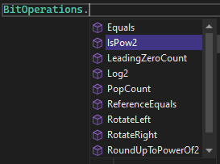
API Improvements
Community-driven
int pid = Environment.ProcessId; string path = Environment.ProcessPath;
byte[] bytes = RandomNumberGenerator.GetBytes(200);
await Parallel.ForEachAsync() (DEMO)

Slide 24
API Improvements
Community-driven
var tcs = new TaskCompletionSource();
PosixSignalRegistration.Create(PosixSignal.SIGINT, context =>
{
Console.WriteLine($"{context.Signal} fired");
tcs.TrySetResult();
});
await tcs.Task;

Slide 25
C# 10 – head line features
Value (readonly) Records + record-like semantics
Interpolated string enhancements
File Scoped Namespaces
Global Using Statements
Implicit Using Statements
Lambda improvements

Slide 26
Interpolated string handlers
public class Person {
public string Name { get; }
public int Age { get; }
public override string ToString() => $"{nameof(Name)}: {Name}, {nameof(Age)}: {Age,4}";
}
//NET6: public override string ToString()
{
var h = new DefaultInterpolatedStringHandler(6, 4);
h.AppendFormatted("Name");
h.AppendLiteral(": ");
h.AppendFormatted(this.Name);
h.AppendLiteral(", ");
h.AppendFormatted("Age");
h.AppendLiteral(": ");
h.AppendFormatted<int>(this.Age, 4);
return h.ToStringAndClear();
}
//NET5
public override string ToString() =>
string.Format( "{0}: {1}, {2}: {3,4}", new[]{ "Name", this.Name, "Age", this.Age });

Slide 27
Constant Interpolated Strings
const string S1 = "Hello world"; const string S3 = $"{S1} Kevin, welcome to the team!";
[DebuggerDisplay($"Count: {nameof(Count)}")] class MyList { public int Count { get; private set; } = 15; }

Slide 28
File Scoped Namespaces
namespace MySystem; class MyClass { }
One per file
Not nested

Slide 29
Global Using Statements
Project-scoped defaults global using System; global using System.Collections.Generic; global using System.IO; global using System.Linq;
Can be static global using static System.Math;
Can use mnemonic using SF = Microsoft.CodeAnalysis.CSharp.SyntaxFactory;

Slide 30
Implicit Using Statements
*.csproj: <ImplicitUsings>enable</ImplicitUsings>
<PROJECT_NAME>.GlobalUsings.g.cs global using global::System; global using global::System.Collections.Generic; global using global::System.IO; global using global::System.Linq; global using global::System.Net.Http; global using global::System.Threading; global using global::System.Threading.Tasks;
<ItemGroup> <Using Remove="System.Threading" /> <Using Include="Microsoft.Extensions.Logging" /> </ItemGroup>

Slide 31
Minimal APIs
Without Rust or Go…
var builder = WebApplication.CreateBuilder(args);
var app = builder.Build();
app.MapGet("/hello", () => "Hello, World!");
app.Run();

Slide 32
Record struct
readonly record struct Rect(
int X,
int Y,
int Width,
int Height);

Slide 33
Record improvements
record class Rectangle(int Width, int Height) {
public sealed override string ToString() => $"{GetType().Name} {Width}x{Height}";
}
record class Square (int side): Rectangle(side, side) {
//public override string ToString() => $"{GetType().Name} {Width}x{Height}";
}

Slide 34
„Record” improvements
readonly struct RectangleStruct {
public int X { get; init; } public int Y { get; init; }
public int Width { get; init; } public int Height { get; init; }
public RectangleStruct() { X = Y = 0; Width = Height = 1; }
public RectangleStruct(int x, int y, int width, int height) { X = x; Y = y; Width = width; Height = height;
}
}
var r3 = new RectangleStruct(1, 2, 3, 4);
var r4 = r3 with { X = 15 };
with „almost” everywhere

Slide 35
Extended property patterns
C# 9 if (e is MethodCallExpression { Method: { Name: "MethodName" } })
C# 10 if (e is MethodCallExpression { Method.Name: "MethodName" })

Slide 36
Generic attributes
public class DefaultValue<T> : Attribute {
public T Value { get; }
public DefaultValue(T value) => Value = value;
}
public DefaultValue(string text) => Value = Nemesis.TextParsers.TextTransformer.Default.GetTransformer<T>().Parse(text);

Slide 37
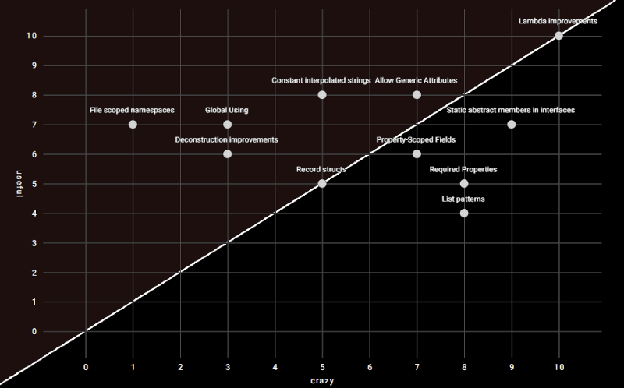
Feature map

Slide 38
Lambda enhancements
var f1 = string () => default; var f2 = ref int (ref int x) => ref x; var f3 = void () => { }; var f4 = async (int i) => i;
Method(int (i) => i); static void Method<T>(Func<T, T> f) { }
Func<string,int> func = int.Parse; MyParser mp = func; public delegate int MyParser(string arg);

Slide 39
Demo

Slide 40
Discussion

Slide 41
The end
Thank you for your attention

Slide 42
Caller Argument Expression
static void Assert(bool condition,
[CallerArgumentExpression("condition")] string message = null)
=> Debug.Assert(condition, message);
May only be used on parameters with default values
Multiple parameters marked with CallerArgumentExpression are permitted
For invalid parameter names compiler will pass in an empty string
Sadly no nameof support

Slide 43
Monoid and Groups aka Generic Math
public interface IParseable<TSelf> where TSelf : IParseable<TSelf> { static abstract TSelf Parse(string s, IFormatProvider? provider);
static abstract bool TryParse([NotNullWhen(true)] string? s, IFormatProvider? provider, out TSelf result); }
public readonly struct Guid : IParseable<Guid> { public static Guid Parse(string s, IFormatProvider? provider) { /* Implementation */ }
public static bool TryParse([NotNullWhen(true)] string? s, IFormatProvider? provider, out Guid result) { /* Implementation */ }
}

Slide 44
API Improvements
PriorityQueue
var shopQueue = new PriorityQueue<string, Job>();
shopQueue.Enqueue("Michał", Job.Developer);
shopQueue.Enqueue("Wojciech", Job.Physicist);
shopQueue.Enqueue("Jarosław", Job.Politician);
while (shopQueue.TryDequeue(out string? name, out Job _))
Console.WriteLine($"Serve now {name}");
public enum Job { Physicist, Developer, Politician }
// Serve now Wojciech
// Serve now Michał
// Serve now Jarosław

Slide 45
API Improvements
File and I/O
public FileStream(SafeFileHandle handle, FileAccess access, int bufferSize, bool isAsync)
Changes to FileStream.Position
Not serialized to OS
Updated after aync operations
Preallocation size and options (RandomAccess, DeleteOnClose, …) specification sealed record FileStreamOptions(/*..., */ FileOptions Options, int BufferSize = 4096, long PreallocationSize);
Vectored (scatter/gather) I/O
Atomicity
Concatenated output
Efficiency
GetLength: faster 33 Times
SeekForward/SeekBackward: 10-100 times faster
Read/WriteAsync: up to 5 times faster
Read/Write: up to 6 times faster

Slide 46
API Improvements
Native alloc
unsafe
{
int* number = (int*)NativeMemory.Alloc(sizeof(int));
*number = 42;
int* numbers = (int*)NativeMemory.Alloc(2, sizeof(int));
numbers[0] = 42;
numbers[1] = 420;
numbers++;
var n = *numbers;
NativeMemory.Free(number);
NativeMemory.Free(numbers);
}

Slide 47
API Improvements
Async
WaitAsync public Task WaitAsync(CancellationToken cancellationToken); public Task WaitAsync(TimeSpan timeout); public Task WaitAsync(TimeSpan timeout, CancellationToken cancellationToken); TimeSpan instead of int !!!
CancellationTokenSource.TryReset if (!cts.TryReset()) cts = new CancellationTokenSource();
TODO periodic timer

Slide 48
Performance improvements
Runtime
TODO
https://s.surveyplanet.com/iusplu0w

Slide 49
Performance improvements
Framework

